Slide 1
EVOLUTION
Biological evolution is a genetic change/change in allele frequencies in a population’s gene pool, not an individual, over time.
Evolution is any change in the frequency of alleles within a gene pool of a population from one generation to the next.

Slide 2
Species
A species is often defined as a group of organisms which can interbreed under natural conditions to produce fertile offspring.
Population:
A group of organisms of the same species living in a defined geographical area at a specific time.;

Slide 3
Definitions
Gene:
A sequence of nucleotides in a DNA molecule that codes for a specific characteristic (e.g. the gene for blood type)
Allele:
An alternative form of a gene. i.e. it is one of two or more forms of the DNA sequence of a particular gene. In other words for the gene blood type, three possible alleles or DNA sequences exist i.e. blood type A, B or O.
Multiple allelic trait: when there is more than two different alleles possibilities for a specific trait or characteristic e.g. blood type has three possible alleles: A, B or O

Slide 4
Allele Frequencies:
Frequency of occurrence of a certain characteristic in a population i.e. how often does a characteristic show up in a gene pool.
GENE POOL
A gene pool the sum total of all of the alleles available among the interbreeding members of a population of a particular species.

Slide 5
Gene-flow is the movement of genes from one population to another or from one part of a population to another as a result of reproduction between individuals from each population.

Slide 6
Variation between individuals
All members of a population vary (i.e. are different in the characteristics that they possess)
Variation that is genetically based (heritable) is passed on to offspring.
Variations between individuals in a population arises by means of:
Mutations - Only mutations in sex cells can be passes on to offspring
Random mating/ random selection of a partner.
Sexual reproduction:
Crossing over of homologous chromosomes prophase 1 of meiosis1 (where chromatids of homologous chromosomes touch, breakage points/chiasma develop and swapping over of genetic material and recombination of sections of DNA between homologs occur.)
Independent alignment of homologous chromosomes on equator during metaphase 1
Independent assortment of homologous chromosomes to poles during anaphase 1: i.e. a gene in a chromosome of one homolog move/assort to a pole independently of genes in another homologous pair.
Chance meeting of sperm and egg cell during fertilisation
Environmental factors e.g. diet , people differ in weight and muscle size – caused by epigenetics.

Slide 7
MECHANISMS OF EVOLUTION
Mutations in germline/sex cells/gametes
Natural selection
Random genetic drift
Founder effect
Migration/geneflow
Genetic diseases with selective advantage over an infectious disease.
Barriers (Isolation)
Environmental change

Slide 8
1. Mutations
A mutation is a sudden, permanent structural alteration in an organism’s DNA, purely by chance.
Mutations are an important source of genetic variation.
In most cases, DNA changes either have no effect or cause harm, but occasionally a mutation can improve an organism's chance of surviving.
Mutations in reproductive cells can be passed on to an organism’s descendants.

Slide 9
Mutations
New variations may occur suddenly by chance. This is known as a mutation.
There are two types of mutations:
Gene mutations which are changes to the DNA of a single gene.
Chromosomal mutations which are changes to a whole or part of a chromosome.
Mutations may occur in two places:
Body cells, known as somatic mutations.
Gametes, known as germline or germinal mutations.

Slide 10
Mutations
Somatic mutations ( changes in the DNA of a body cell )only affect the individual with mutation.
Germline mutations occur in sex cells and can be transferred to offspring and are the only type of muttion that can be of an evolutionary advantage if it has an selective advantage and increase its frequency in a gene pool.

Slide 11
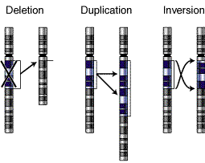
Types of mutations
National Human Genome Research Institute - NIH

Slide 12
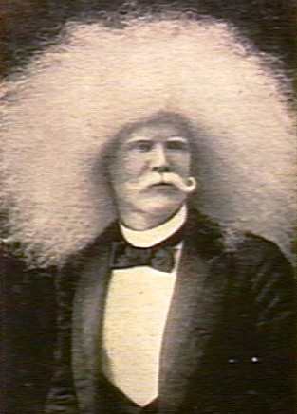
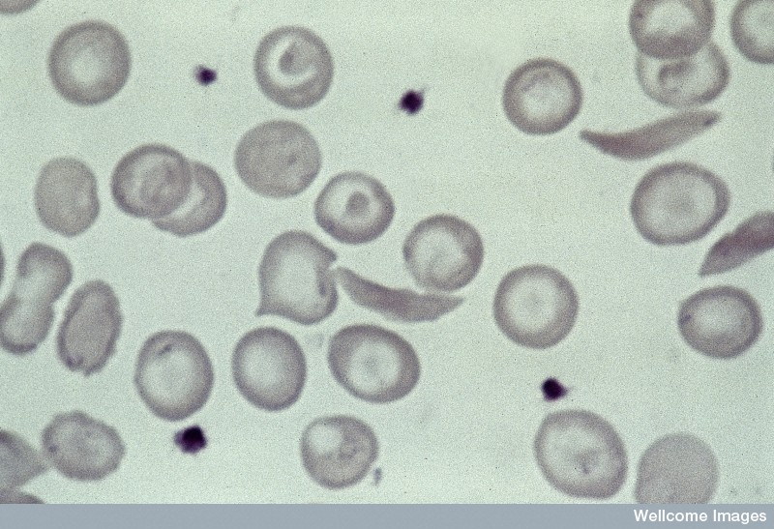
Albinism (left) and sickle cell trait (above) result from mutations.
Many human conditions result from genetic mutations.
Some, such as the sickle cell trait, are beneficial in some situations; whereas others, such as cancer, can be lethal.
Wellcome Photo Library

Slide 13
2. Natural selection
In large populations:
Individuals make only a small contribution to the gene pool, therefore evolution is change in allele frequencies in the gene pool of population.
Evolution occurs slowly.
Most changes are adaptive.
Natural selection is the main driving force.
Natural selection acts on the phenotype of an individual.

Slide 14
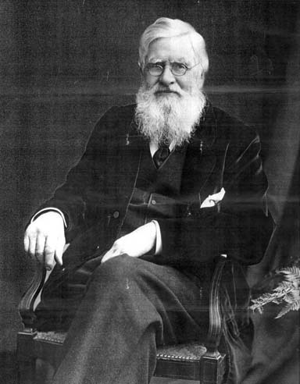
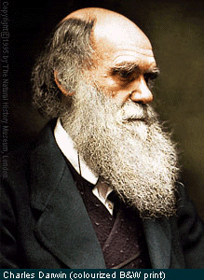
2. Natural selection
Alfred Wallace
Charles Darwin
Natural selection is the scientific theory proposed by Charles Darwin and Alfred Wallace that organisms best adapted to their environment tend to survive and out-multiply those that are less well adapted.

Slide 15
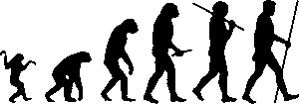
Natural selection
Natural selection provides a plausible explanation for evolution.

Slide 16
Darwin’s Theory of natural selection was based on three observations:
Variation: all members of a species vary, but Darwin didn’t know why (He did not know anything about genetics.)
Birth Rate: all living organisms increase their numbers at a far greater rate than their resources e.g. food.
Nature remains balanced: although birth rate is very high, each species tended to maintain their numbers at a constant rate. This can be explained by the concepts of: struggle for survival and survival of fittest.

Slide 17
Modern understanding of natural selection : neo-Darwinism
Variation in Phenotype must exist e.g. there must be short or tall people in a community or slow and fast runners. Variation caused by mutations in germ cells and sexual reproduction
Mutation of a gene is the only way new allels can be added to a gene pool
More off spring are produced than can survive.
An environmental selection pressure, must exist. A selection pressure is any factor that threatens thee survival of a species e.g. predators, climate, competition etc.
A struggle for survival exists in which there is a “survival of the fittest”. There could be competition for food, space, water, avoiding predators, and finding mating partners. The individuals with favourable characteristics/alleles will survive at a greater rate than those without the favourable characteristics. E.g. fast runners can outrun predators.
Survival of the fittest refer to individuals ability to survive and reproduce.
The better-adapted individuals/with favourable alleles will reproduce and pass their favourable alleles to their offspring i.e. the allele frequency of the favourable characteristic will increase in the population.
The same selective pressure must act on the population over many generations in order for the frequency of the favourable allele to increase in the gene pool
Over a period of time natural selection will result in a population becoming better adapted to its environment.

Slide 18
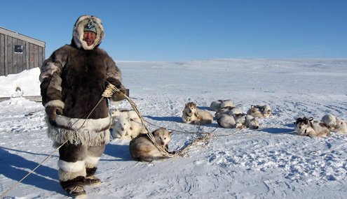
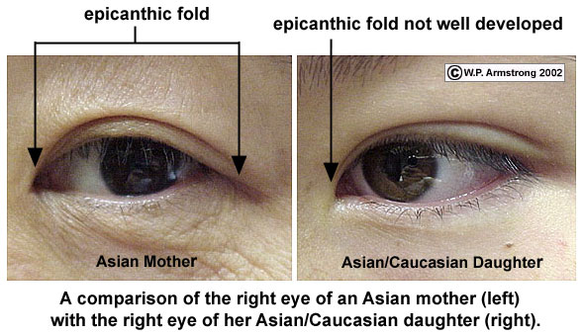
Human body shape, or stature, can be correlated with resistance to the cold. People living in extreme cold tend to be short with long trunks and short limbs. This shape appears to conserve as much heat as possible. Their broadly built faces and Mongolian (epicanthic) eye folds seem to be adaptations to protect their face and eyes from exposure to the cold. Eg Inuits.

Slide 19
EPICANTHIC FOLD:
The epicanthic fold is the skin fold of the upper eyelid, covering the inner corner (medial canthus) of the eye. Various factors influence whether epicanthic folds form, including ancestry, age, and certain medical conditions.
Possible evolutionary function of the epicanthic fold
The epicanthic fold is often associated with greater levels of fat deposition around the eyeball, a feature most accentuated in native North Siberian, Aleut and Inuit populations. The adipose tissue is thought to provide greater insulation for the eye and sinuses from the effects of cold, especially from freezing winds, and to represent an adaptation to cold climates. It has also been postulated that the fold itself might provide a level of protection from snow blindness. Though its appearance in peoples of Southeast Asia can be linked to possible descent from cold-adapted ancestors, its occurrence in various African peoples precludes a cold-adaptive explanation for it appearing in the latter groups. The epicanthic fold found in some African people has been tentatively linked to protection for the eye from the high levels of ultra-violet light found in desert and semi-desert areas.^{[13]}

Slide 20
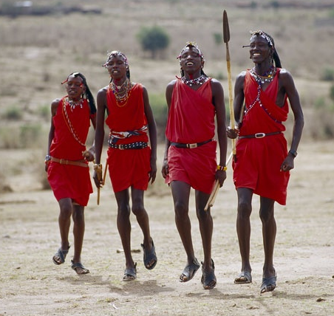
People populating regions where temperatures are very high tend to have short bodies with long limbs. This shape facilitates the loss of heat, as the surface of the body is much greater when compared to body volume than it is for people with long bodies and short limbs. E.g. Sudanese, Ethiopians, Zulus

Slide 21
Outline changes that have occurred in the Eskimo and African body shapes, assuming they came from the same gene pool.
Inuit (Eskimo) – individuals with long bodies and short limbs possess a survival advantage (sometimes referred to as a “selective” advantage) in cold climates. Those with short bodies and long limbs would have found survival more difficult, or may not have survived at all.
“African” – individuals with short bodies and long limbs have a survival advantage in hot dry conditions. Those with long bodies and short limbs would not have survived.

Slide 22
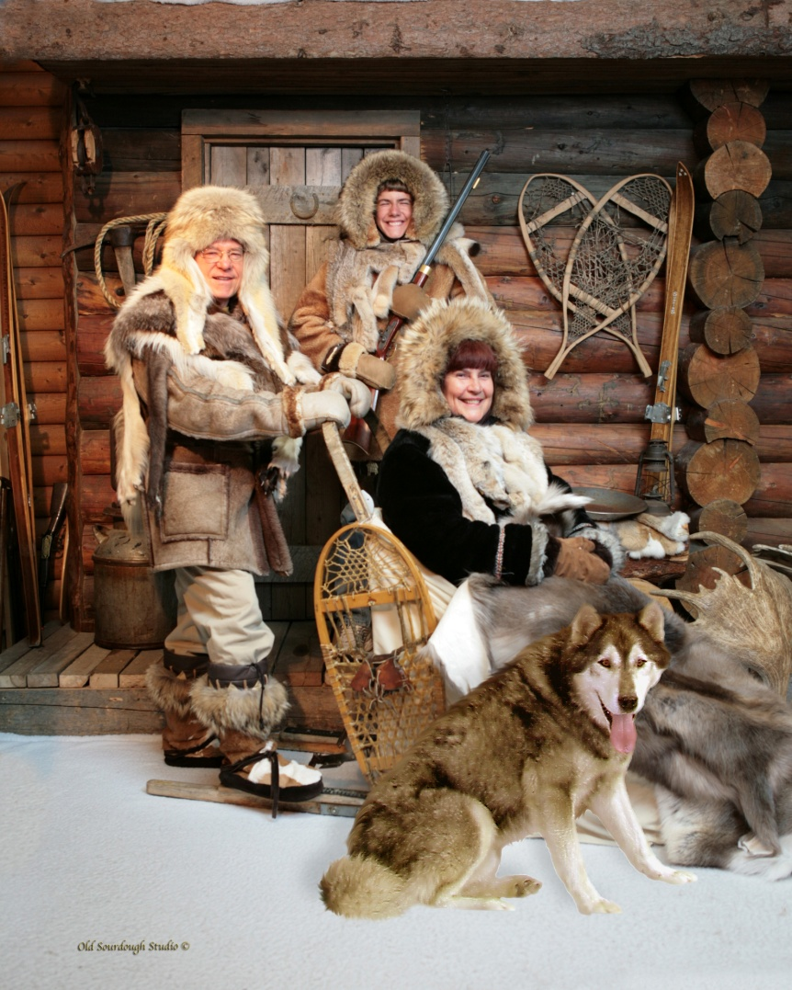
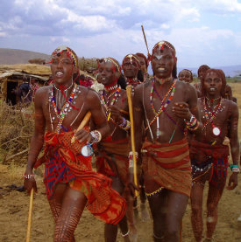

Slide 23
Genetic Diseases
Genetic diseases also result in changes to allele frequencies.
It would be expected that an allele causing an inherited, fatal disease would be expected to gradually be eliminated from a population.
Sometimes alleles that cause disease persist in populations. This is especially true if two of the alleles are needed to cause the disease, but being heterozygous is advantageous.

Slide 24
Sickle cell anaemia
Occurs mainly in black Africans
Sickle cells are formed because of a mutation of one of the amino acid genes in beta amino acid chain consisting of 287 amino acids in the haemoglobin molecule.
where adenine is replaced by thymine causing replacement of one glutamic acid with a valine molecule. Cells that contain the mutation of haemoglobin-S collapse in a crescent or sickle shape and individuals homozygous for condition suffer from sickle-cell anaemia, fatal condition.

Slide 25
Cont.
Sickled cell can’t carry sufficient oxygen. After defective hemoglobin molecules release their oxygen, they cluster into rodlike structures that push against the cell’s membrane, bending it into a sickle shape. Because sickle cells have a much shorter life span than normal cells, anaemia results.
Usually fatal inherited condition.
The more severe symptoms (crippling pain, strokes and early death) come when sickle cells, which are rigid, clog vessel openings, blocking the flow of blood to vital organs and extremities.

Slide 26
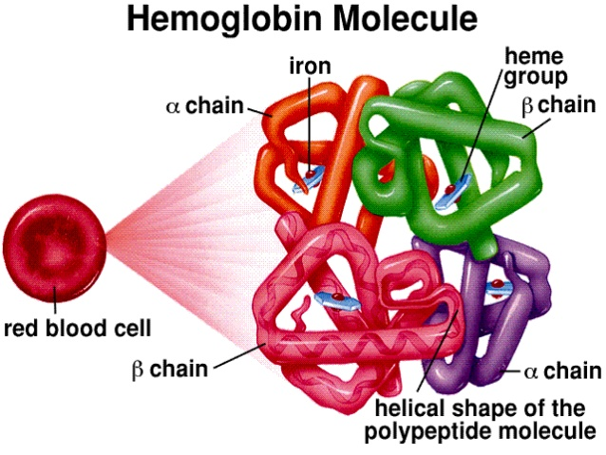

Slide 27
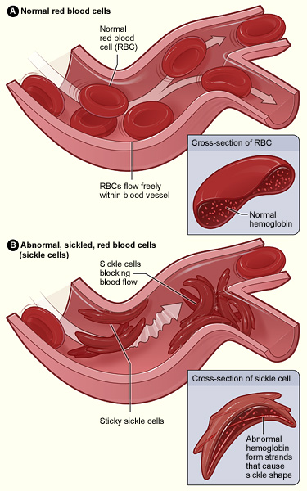
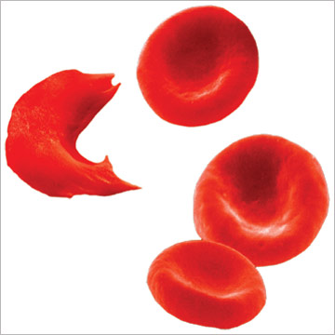
Sickle cells vs normal red blood cells

Slide 28
Why has this fatal gene not died out yet?
Selective advantage mutation:
People with the mutated gene is more likely to survive
Mutated gene has survival advantage and people are more likely to be able to reproduce and pass on the mutated allele.
Advantage of being a sickler: Link between malaria and sickle-cell allele
Person that carries the sickle gene but has not got the condition, is called a sickler.
Half their cells are normal biconcave RBC and half is sickled. Sickled and non- sickled cell alleles are co-dominant.
Variation in population: Heterozygotes show no effect unless oxygen in short supply, cells then show mild sickling and blood has reduced oxygen-carrying capacity and person is lethargic/lack of energy.
Selective agent: malaria virus, selective advantage – sicklers (carriers of haemoglobin-S), malaria parasite cannot successfully reproduce in sickle-shaped re blood cells and therefore minimise the spreading of the parasite.
Carriers (heterozygous co-dominant) of this gene show a natural resistance against malaria and is example of natural selection in action.
Sickle cell gene is favoured in malarial prone areas.
Those with trait are more likely to survive and reproduce in these ares.
Frequency of the sickle cell allele increase in these populations in malaria areas.

Slide 29
Tay-Sachs disease – recessive autosomal disease
Caused by a mutation on chromosome 15 that cause a defect in a gene that code for enzyme hexosaminidase A (hexa A) located in lysosomes. Within lysosomes this enzyme break down fat-protein waste substances called ganglioside. If HEXA gene is disrupted, that leads to accumulation of a gangliosides in neurons in the brain and spinal cord. Progressive build up of gangliosides leads to destruction of neurons causing symptoms e.g. blindness, deafness and reducing the ability to swallow.
Baby will develop normally for first few months and then deterioration causing mental and physical disabilities and seizures begin. Losing ability to crawl. Death usually in early childhood around age 4-5.

Slide 30
Tay-Sachs disease
No cure but pain and be relieved with medication and seizures can be managed.
Occurs more frequently in people from Jewish descent (Ashkenazi Jews) from Eastern Europe. This group can trace ancestors back 600-800 years ago to group of 330 people that only married within their faith for a long period.
Also found in non-Jewish French Canadian descendants, especially those living in Cajun community of Louisiana and south-eastern Quebec.
Causing double recessive alleles to increase in this gene pool.

Slide 31
Why has this fatal Tay-sachs gene not died out yet?
Although a fatal gene the allele frequency of this gene is still high in the population mentioned in the previous slide.
Seems that carriers (heterozygotes) have increased resistance to tuberculosis (TB) and therefore survival advantage that can be passed on to offspring
It is now known that carriers of the Tay-Sachs gene have increased production of the β-subunit of hexosaminidase¹⁷ and that the β-subunit is closely associated with increased host defense against mycobacteria.¹⁸
Additionally, cell surface bactericidal activity declined in the absence of β-hexosaminidase. It is therefore possible that β-hexosaminidase is cytotoxic to Mycobacteria tuberculosis, making the organism more susceptible to macrophage attack.¹⁸ In the advent of drug-resistant tuberculosis, developing drugs that up-regulate or maintain β-hexosaminidase may prove beneficial for the treatment of tuberculosis while circumventing concerns of antibiotic resistance.

Slide 32
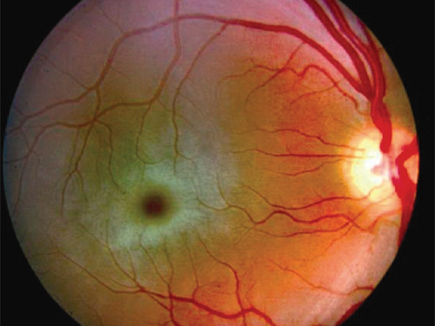
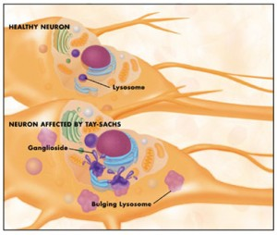
Tay-Sachs: symptom – cherry red spot observed in the eye. Fat storage in central area of retina around the macula. Red spot is because no fat deposits in macula/fovea area where there are lots of cones.

Slide 33
Thalassemia
Thalassemia, or Mediterranean anemia, was first described in 1925 by a Detroit physician who studied Italian children with severe anemia (low levels of red blood cells), poor growth, huge abdominal organs, and early childhood death.
In 1946, the cause of thalassemia was found to be an abnormal hemoglobin structure, caused by a mutation that caused alterations of genes that produces either the alpha or beta heamoglobin chains.
The body reacts by destroying red blood cells, causing anemia. To compensate for the loss, the body tries to make red blood cells more rapidly, causing other thalassemia complications, such as bone abnormalities and spleen enlargement.
In the 1960s, doctors treating thalassemia patients started to transfuse them with fresh red blood cells every month. This alleviated most of the childhood symptoms and led to a major improvement in survival. It is still used as a treatment today.
However, since blood contains large amounts of iron, which the body cannot eliminate naturally, most patients died in their teenage years from damage caused by too much iron.

Slide 34
Thalassemia
Researchers later found that excess iron could be removed from the body by treatment with a drug called deferoxamine. This is chelation therapy.
The drug binds with iron and helps to remove excess iron from the body.
This drug prevented iron-induced heart disease and helped patients live much longer. Recently, two oral drugs have become available to remove iron. They have dramatically improved the quality of life of patients with iron overload from transfusions for thalassemia. Furthermore, specialized imaging tests can now find iron in the heart and allow patients to be treated before they develop iron-related heart failure.
As with sickle cell disease, drugs that increase production of fetal hemoglobin can partially correct the anemia of thalassemia, but efforts to improve the treatment of thalassemia continue.
Thalassemia is a genetic blood disorder that is associated with a reduction in haemoglobin in red blood cells and, subsequently, insufficient oxygen reaching cells in the body. However, individuals with this condition may actually be at an advantage when it comes to certain diseases, such as malaria, as it may offer a protective effect.

Slide 35
halassemia is a genetic blood disorder that is associated with a reduction in haemoglobin in red blood cells and, subsequently, insufficient oxygen reaching cells in the body. However, individuals with this condition may actually be at an advantage when it comes to certain diseases, such as malaria, as it may offer a protective effect.
Protection from Malaria
Malaria is a potentially lethal condition that is common in areas with a tropical or subtropical climate, where the prevalence of thalassemia is similarly high.
Some research has suggested that people with thalassemia are less likely to suffer from malaria, due to a protective effect of the condition. It appears that smaller quantities of haemoglobin in more cells – a distinctive characteristic of thalassemia – may offer an advantage against malaria.
WHY A SELECTIVE ADVANTAGE TO HAVE THALASSEMIA?:
People with thalassemia are less likely to suffer from Malaria
Malaria is a potentially lethal condition that is common in areas with a tropical or subtropical climate, where the prevalence of thalassemia is similarly high.
Some research has suggested that people with thalassemia are less likely to suffer from malaria, due to a protective effect of the condition. It appears that smaller quantities of haemoglobin in more cells – a distinctive characteristic of thalassemia – may offer an advantage against malaria.
According to the research, children with mild alpha-thalassemia have a natural protection against the anemia associated with malaria. The study was conducted in Papua New Guinea and included 800 children as participants in the study. In this region, malaria is endemic and a high percentage of children also have alpha-thalassemia.
For severe cases of malaria, an individual can lose 30-50% of total red blood cells and lead to anemia in the blood. However, children with alpha-thalassemia tended to recover more easily after experiencing a malaria attack.

Slide 36
Thalassemia
Although the reason for this is not certain, it is thought to occur as a result of the increased number of red blood cells present in children with thalassemia. They typically possess 10-20% more red blood cells than individuals without thalassemia and, thus, a reduction in number is less likely to cause serious damage.
This unusual benefit of thalassemia is a simple consequence of the body’s response to the reduction in haemoglobin in the blood. Their body produces more cells to compensate, which then offer a protective effect against another disease that is also prevalent in the same region.
Given the significant impact of malaria, particularly on global mortality of children, this benefit of thalassemia is notable. Up to two million deaths occur every year in Africa and Asia due to malaria and in many of these regions genetic mutations have arisen, offering a form of protection.
The potentially beneficial effect of other types of thalassemia, such as beta-thalassemia, has not yet been established. However, it is possible that there are similar protective effects against malaria in other types of thalassemia.

Slide 37
In small populations:
Individuals make a relatively large contribution to the gene pool.
Evolution can occur rapidly.
Many changes are non-adaptive.
Many changes are due to chance events.

Slide 38
4. Genetic drift
Genetic drift is the random fluctuation of allele frequencies in a population, random change in the gene pool with time due to chance rather than natural selection.
No selective agent. Non directional.
(e.g. the frequency of a particular trait could, for no obvious reason, drift from 2% in generation 1, to 11% in generation 2, to 5% in generation 3 etc.)
Genetic drift is more likely to occur in small genetically isolated populations.
Genetic drift is often a consequence of a genetic bottleneck i.e. it results from inbreeding brought about by the limited mating possibilities in a small community.

Slide 39
Random Genetic Drift cont - examples
Aborigines on Mornington Island and Bentick Island. These islands were originally part of the mainland (so interbreeding occurred) but became separated due to sea level rises.
Have a high proportion of I^{B} allele and almost no I^{A} allele, but mainland has opposite ratios
* The environment was the same as the larger population (so no selective advantage) but the allele frequency was very different.*

Slide 40
Random Genetic Drift
The change in frequency is “directionless” as there are no selective pressures. Chance events can cause frequencies in a population to change overtime. When chance effects operate, the direction of the change is unpredictable and can vary from generation to the next. The resulting pattern of change is known as “Random Genetic Drift”. The smaller the population size, the greater the potential impact of genetic drift.
In a very small population, genetic drift can lead to the decrease and eventual loss, of favourable alleles form the gene pool or it can lead to an unfavourable allele or rare gene becoming fixed in the gene pool., purely by CHANCE. For this reason, when a species is reduced to one or a few small populations, the species is at great risk of extinction. Genetic drift is important when a population size is dramatically reduced by a major calamity, for example, in a population of bottlenecks. The few survivors that reproduce to give the next generation may be an unrepresentative sample of the original population.

Slide 41
Genetic drift cont…
Genetic drift is the random fluctuation of allele frequencies in a population from one generation to the next i.e. not due to natural selection. (e.g. the frequency of a particular trait could, for no obvious reason, drift from 2% in generation 1, to 11% in generation 2, to 5% in generation 3 etc.)
Genetic drift is often a consequence of a genetic bottleneck i.e. it results from inbreeding brought about by the limited mating possibilities in a small community.

Slide 42
Genetic drift Cont.
The change in frequency is “directionless” as there are no selective pressures. Chance events can cause frequencies in a population to change overtime. When chance effects operate, the direction of the change is unpredictable and can vary from generation to the next. The resulting pattern of change is known as “Random Genetic Drift”. The smaller the population size, the greater the potential impact of genetic drift.
In a very small population, genetic drift can lead to the decrease and eventual loss, of favourable alleles form the gene pool or it can lead to an unfavourable allele or rare gene becoming fixed in the gene pool., purely by CHANCE. For this reason, when a species is reduced to one or a few small populations, the species is at great risk of extinction. Genetic drift is important when a population size is dramatically reduced by a major calamity, for example, in a population of bottlenecks. The few survivors that reproduce to give the next generation may be an unrepresentative sample of the original population.

Slide 43
Random Genetic Drift cont - examples
Aborigines on Mornington Island and Bentick Island. These islands were originally part of the mainland (so interbreeding occurred) but became separated due to sea level rises.
Bentick island became completely isolated, occupants show increased allele frequency for blood type B and complete absence for blood type A, unlike the mainland inhabitants which shows the opposite.
* The environment was the same as the larger population (so no selective advantage) but the allele frequency was very different.*

Slide 44
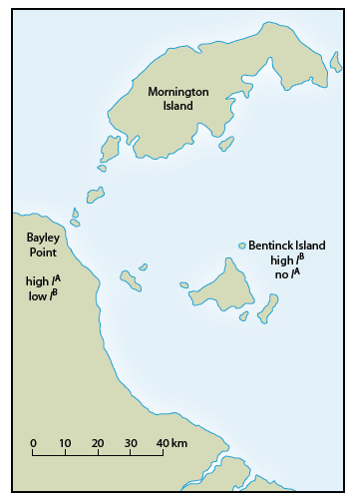
(Newton.T.J. 2010)

Slide 45
BOTTLENECK EFFECT
Anything that creates a sudden drop in population size (e.g. wars, natural disasters or migration), or prevents individuals from breeding, reduces mating possibilities and can cause a genetic bottleneck.
the population is vastly reduced in number and only a few individuals (and therefore genes) survive or are left behind.
the gene pool of surviving population is not the same as original population

Slide 46
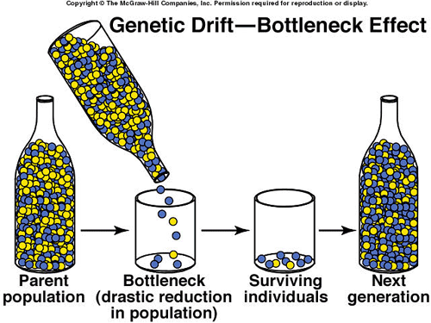
Bottleneck effect

Slide 47
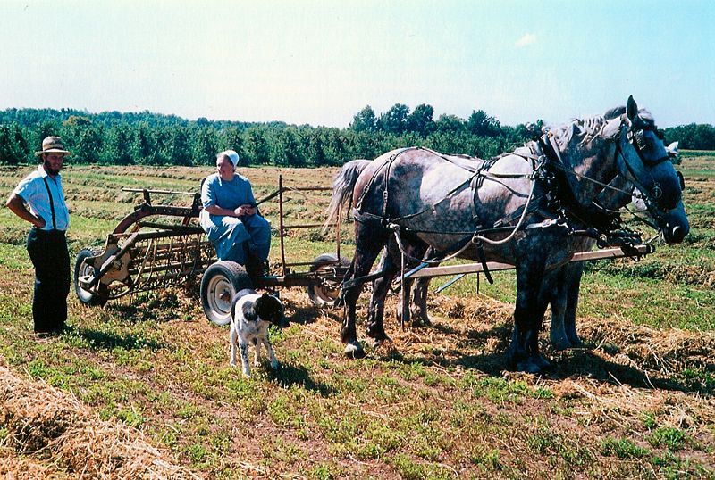
Consanguinity
Ernest Mettendorf
the Old Order Amish community of Lancaster County in Pennsylvania, USA is a fundamentalist religious sect who do not marry out or use modern technology.
The Amish community numbers around 18 000 people and shares only eight family names.
Within the community there is an above average incidence of inherited illnesses including a rare form of microcephally (small brain), albinism, dwarfism, cretinism, webbed fingers and limb girdle muscular dystrophy.

Slide 48
E.g. 2 - Founder effect
When a small group moves away from its homeland to a new area and the population increases.
The migrant group is such a small representative of the original population that it is not a good genetic representation.
Pitcairn Island in the Pacific – less genetic variation
Tristan da Cunha
Finland

Slide 49
E.g. 3 – effect of natural disaster
Pingelap island in Micronesia
Typhoon reduces pop to 20.
One person had Acromatopsis allele (total colour blindness).
This pop has 5% achromatopsia
The rest of the world is 0.0033%

Slide 50
Founder effect
The founder effect is a special case of genetic drift, occurring when a small group in a population splinters off from the original population and forms a new one.
Occasionally a small number of individuals from a population may migrate away, or become isolated from, their original population. If the colonizing or “founder population” is made up of only a few individuals, it will probably have a non-representative sample of alleles from the parent populations gene pool.
As a consequence of this Founder Effect, the colonizing population may evolve in a different direction to that of the parent population, particularly since the environmental conditions for the isolated population may be different.
In some cases, it may be possible for certain alleles to be missing altogether from the individuals in the isolated population. Future generations of this population will not have the allele.
Or a few individuals carrying a recessive allele that can become fixed in the founder population because of restricted breeding/inbreeding/ lack of geneflow/ isolation from other populations.

Slide 51
5. Barriers to gene flow: Isolation
Gene flow may be prevented between members of a by natural or artificial barriers resulting in isolation.
Isolation can result in a change in gene pool. When all or part of a population is separated from the rest of the species, creating two populations. If isolation remains for some time, can eventually lead to separate species (speciation).
While the genes or DNA may still be compatible in the two populations, they may no longer interbreed. Changes in the DNA while the populations were isolated, due to mutations may make the two populations unable to interbreed even when the physical barrier is removed.

Slide 52
Geographical isolation:
When a physical barrier for example mountain ranges, deserts, oceans or manmade unsuitable habitat (e.g. clearing of land for farming) etc, prevent two groups of the same species from meeting and interbreeding.
The environmental conditions on either side of the barrier frequently differ. This leads to the group on each side of the barrier adapting to its own environment- adaptive radiation.

Slide 53
A barrier is formed which divides the population into two. No interbreeding is able to occur between the two populations. Each population has a separate gene pool
Isolations can take the form of
Geographical barriers – countries, distance
Cultural – racial, ethnic,
Social – class, wealth

Slide 54
Migration
Migration can change allele frequency of a population quite quickly. Immigration can introduce new genes form a gene pool and emigration can cause genes to be lost to other gene pools.

Slide 55
6. Migration
Migration is gene flow from one population to another.
Immigration brings alleles into a population
E.g.
Chinese population was all Rh+ but immigrants and sailors introduced Rh- in the 16th century.
I^{B} allele across Europe and Asia.
Aboriginal resistance to diseases from Europe

Slide 56
Speciation
Acknowledge variation in characteristics in given population (list any obvious from question)
A breeding population becomes isolated from original population. (identify isolation mechanism from example)
Gene flow ceases between two separated groups (i.e. no more interbreeding possible because of barrier)
The two separated groups are now exposed to different selective pressures and undergo natural selection independently (identify any selective pressures from example).
Different characteristic (allele frequencies) can arise by mutations, random genetic drift, founder effect and migration) Identify suitable examples
Because of number 4 and 5 only organisms with favourable features survive and can reproduce successfully, others do not survive.
Offspring inherit favourable characteristics.
Allele frequency for these characteristics increase independently in two groups.
Isolated groups comes to possess many different features from original population over many generations.
If the two groups are reunited and interbreeding is no longer possible under natural conditions to produce fertile offspring,
New species has been produced.

Slide 57
Step 1 - isolation
New population established adjacent to, or in isolation from the parent population
Sub-population formed within the parent population
Speciation can occur in several ways.
Isolation of a breeding population – this can either occur within the parent population (e.g. race or religion) or in isolation from the parent population (e.g. migration).
In both cases, interbreeding (gene flow) between the two populations is disrupted.

Slide 58
Step 2 - adaptation
As a result of natural selection, the sub-population adapts to its new environment.
If the sub-population is small, changes to its gene pool can be amplified by random events, such as founder effect and genetic drift.

Slide 59
Step 3 – reproductive isolation
Reproductive isolation occurs if the two populations become sufficiently different (structural, behavioural, physiological or genetic) that they can no longer interbreed, or produce fertile offspring.
If this occurs, the two populations will be regarded as different species.

Slide 60
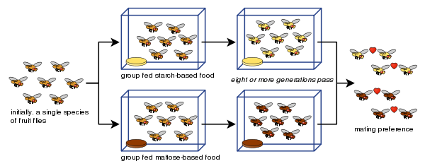
Speciation demonstrated using fruit flies

Slide 61
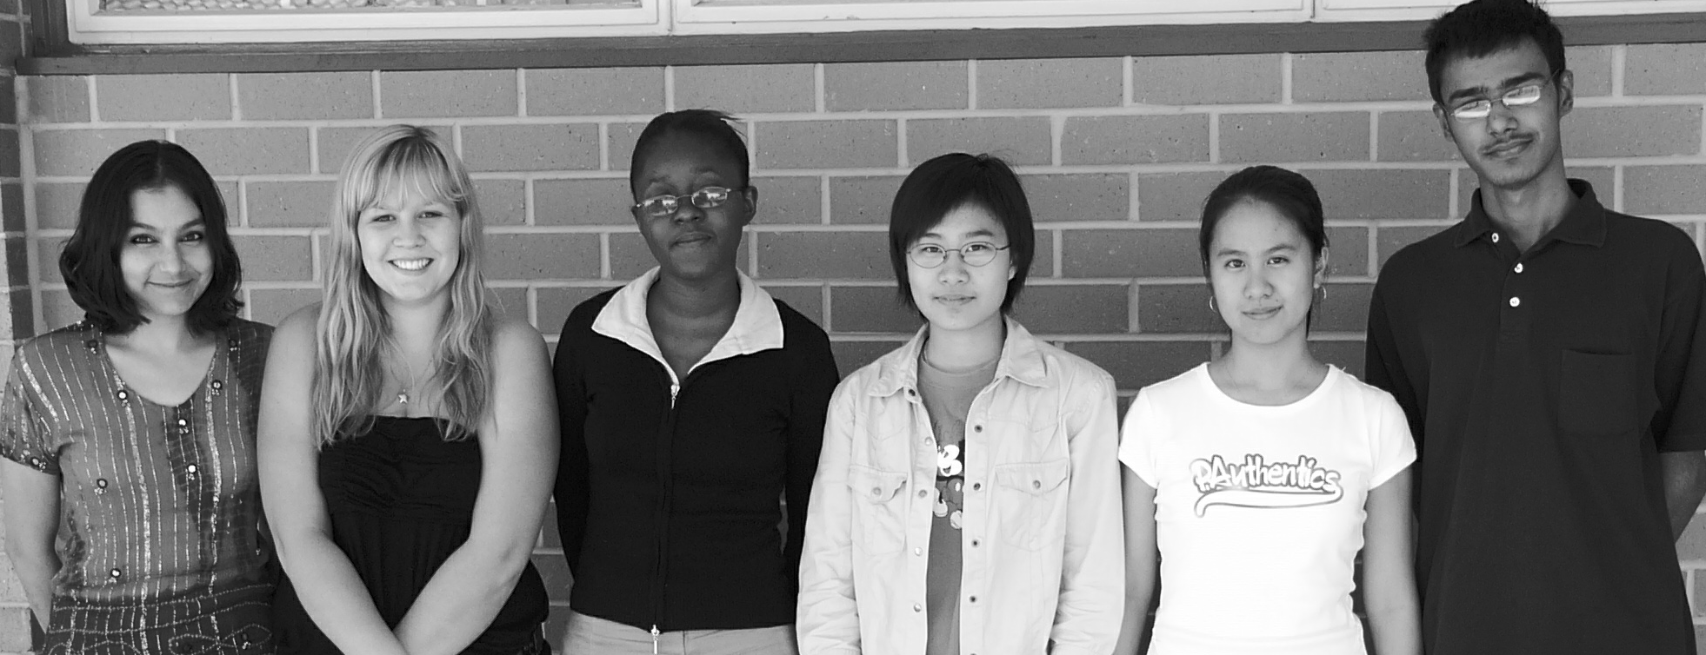
Homo sapiens
Today there is only one human species – Homo sapiens.

